Slide 1




LOGO
Khmershop
login
Cart
Category
Shop Now
Contact Us
Help
My market material
Information

Slide 2
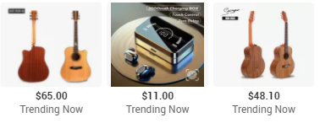
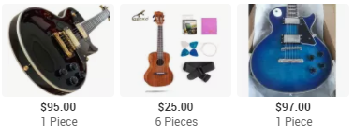
Our Products
New product
Top ranked product
Personal protect Equipment
Drop shipping
Global product
Local product

Slide 3
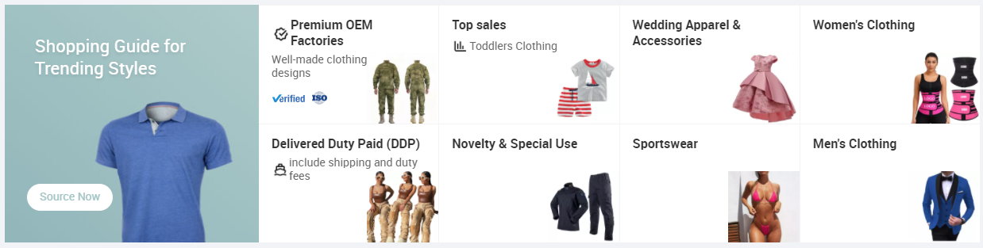
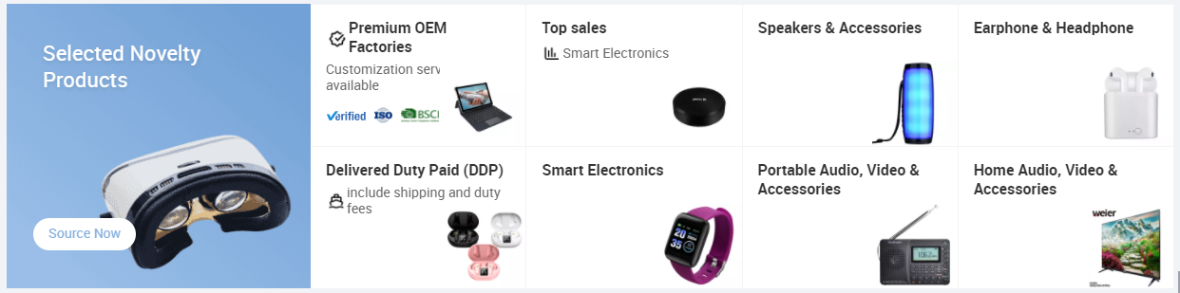
CLOTHES SHOPPING
ELECTRONICE SHOPPING

Slide 4
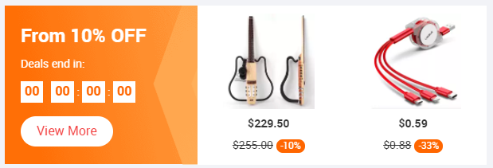
Food Shopping
picture
Weekly Discount Detail

Slide 5
Category
Clothes
Electronics shopping
Foods

Slide 6
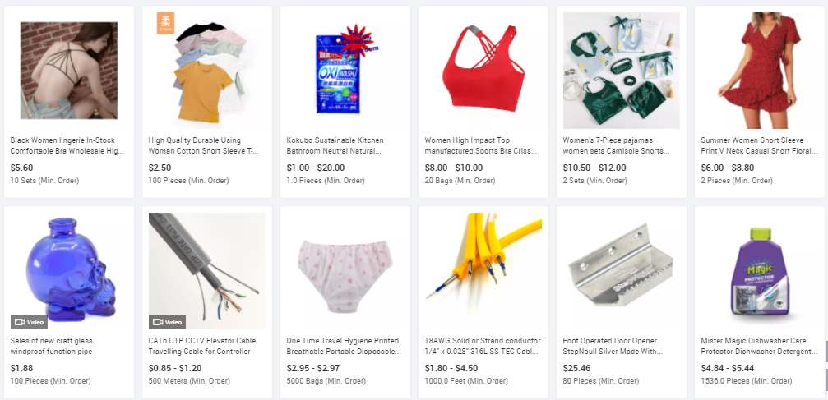
Shop Now ( jus example)

Slide 7
Shop Now
+ Add product
Picture
Picture
Picture
Title
Title
Title
100$
200$
300$
Buy Now
Edit
Delete
Buy Now
Edit
Delete
Buy Now
Edit
Delete

Slide 8
+ Add product
Product Name
Price
Choose file
Cancel
Create

Slide 9
+ Update product
Product Name
Price
Update

Slide 10
Contact Us
First Name
Last Name
Email address
Phone
Male
Female
Massage
Submit
Cancel

Slide 11

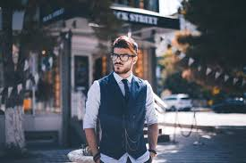

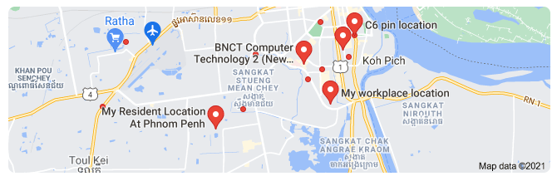
Our Team and Service here
Selina Michal
Jack Van
Mark Zuckerberg
My location

